Slide 1
HOSTEL MANAGEMENT SYSTEM
DEPARTMENT OF COMPUTER SCIENCE & INFORMATION TECHNOLOGY
ARKA JAIN UNIVERSITY, MCA
Arunabh Das
AJU / 221788
Under the guidance of
Dr . Arun Kumar Marandi Dr . Arvind Kumar Pandey
(Internal Guide) (Head Of Department)

Slide 2
PRESENTATION AGENDA
ABSTRACT
SYSTEM REQUIREMENTS
MODULES
E-R DIAGRAM
DATA FLOW DIAGRAM
NORMALIZATION
SCREENSHOTS
CONCLUSION

Slide 3
ABSTRACT
The “Hostel Management System” is an application developed for managing various activities, such as student admissions, student referenced room allotment, hostel booking, viewing hostel booking details.
This project deals with the problems of managing hostel to avoids the problems which occurs when carried manually. This application is useful to avoid the manual data entry and is easy to access the data about the hostels. Thereby, the management of hostel becomes easier to maintain and access.
The main objectives of the project are to reduce the human effort and processing time in maintaining the student data living in the hostel.

Slide 4
SYSTEM REQUIREMENTS
Software Requirements :
Operating System | Windows 10
Front End | HTML , CSS
Back End | PHP
Database | MYSQL
IDE | VS Code
Tool | XAMPP Control Panel
Hardware Requirements :
Processor | Intel (R) core (TM) i5-6200U
Ram | 4 GB
Hard Disk | 1 TB Hard Disk

Slide 5
MODULES
This system mainly contains the following modules.
Admin Module
Register Student
Manage Students
Book Hostel
Manage Hostel Students
Manage Rooms
Student Module
Book Hostel
View Hostel Details

Slide 6
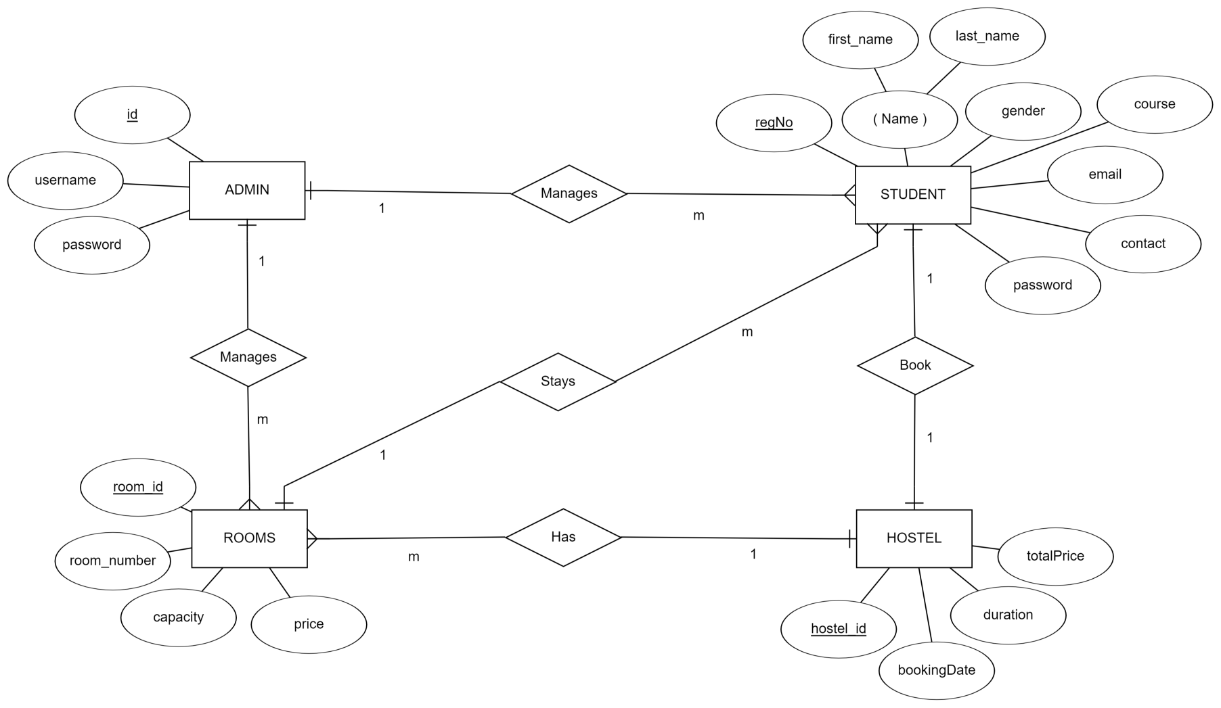
E-R DIAGRAM

Slide 7
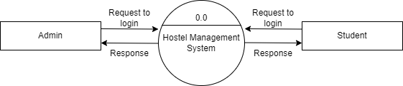
DATA FLOW DIAGRAM
CONTEXT LEVEL DFD

Slide 8





LEVEL 1 DFD (ADMIN)

Slide 9




LEVEL 1 DFD (STUDENT)

Slide 10





LEVEL 2 DFD

Slide 11
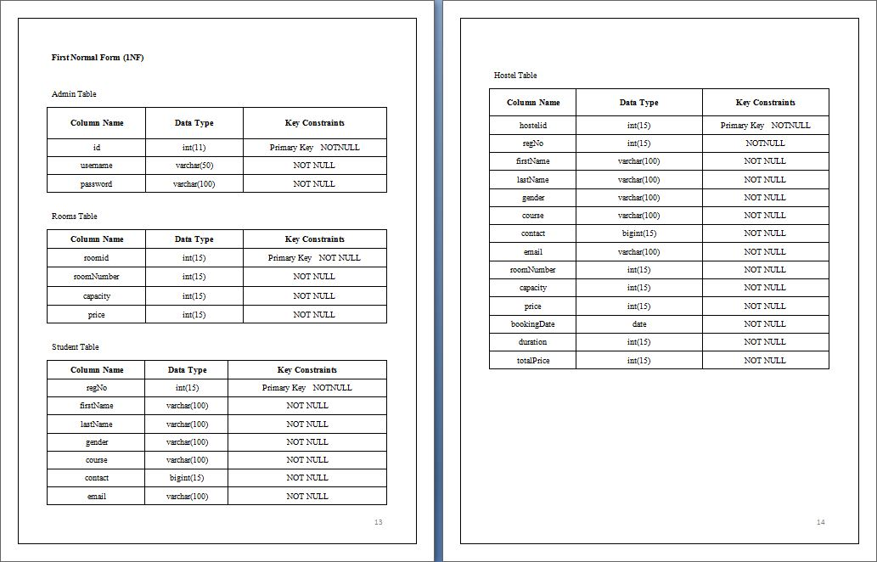
NORMALIZATION

Slide 12
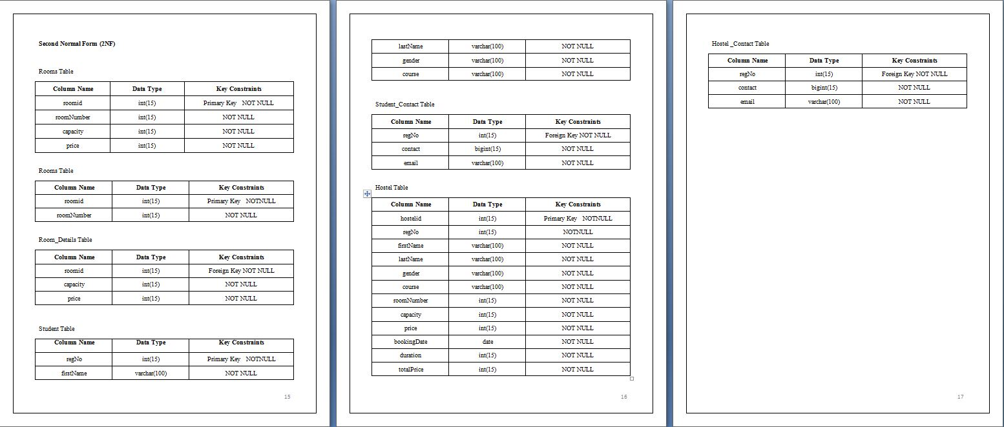
2 NF

Slide 13
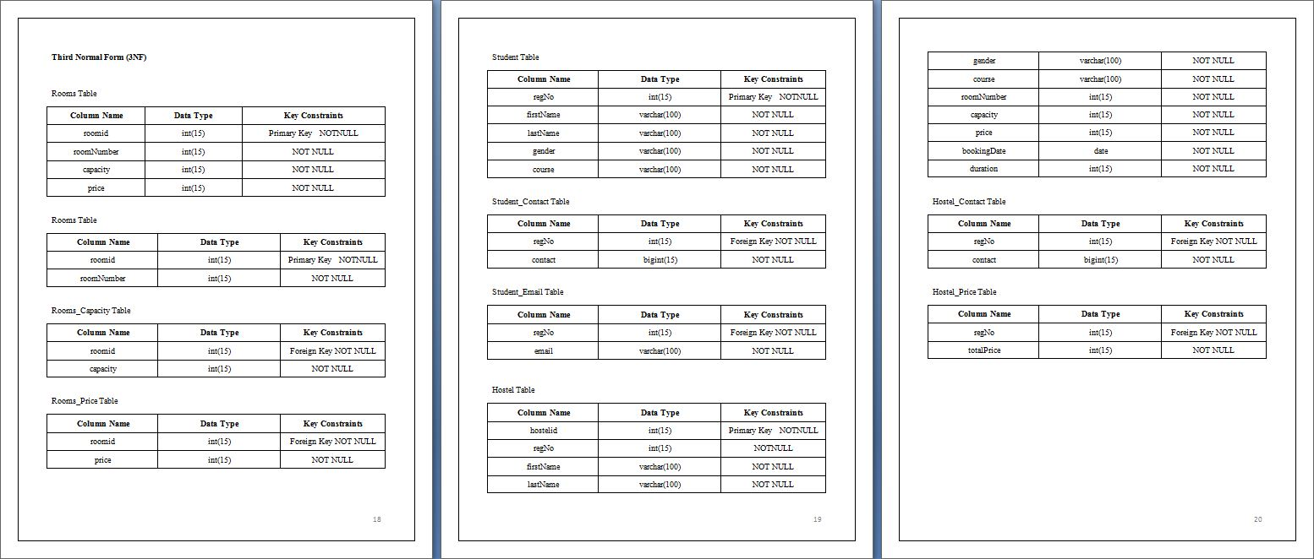
3 NF

Slide 14
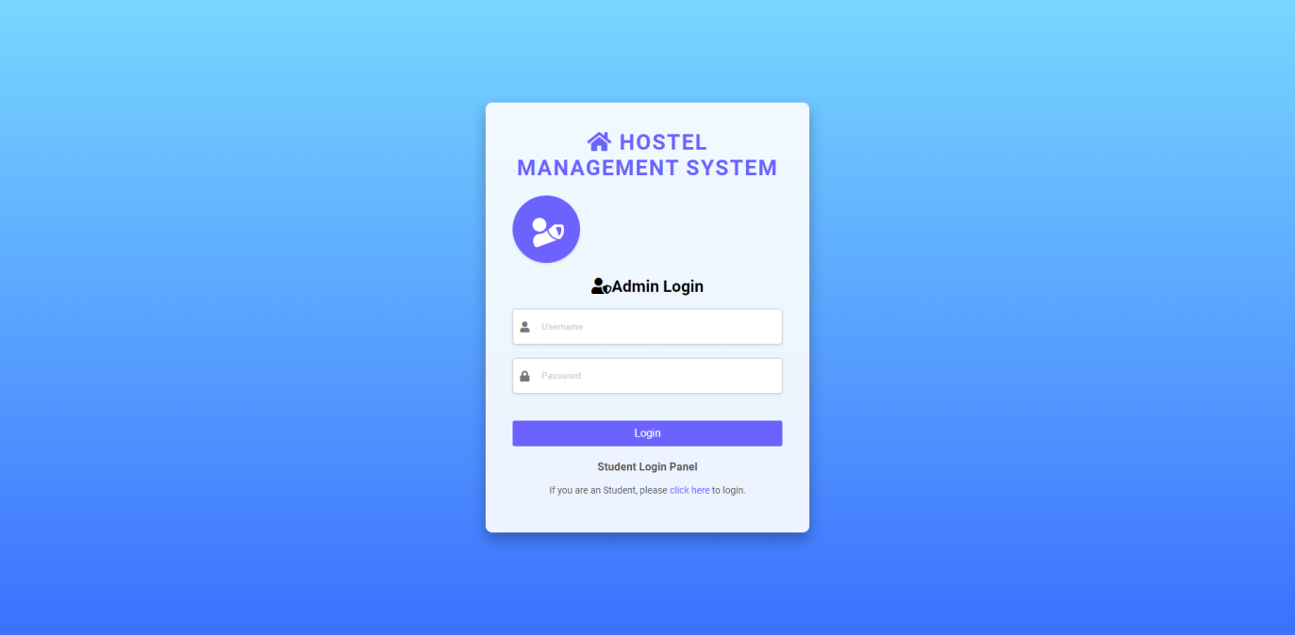
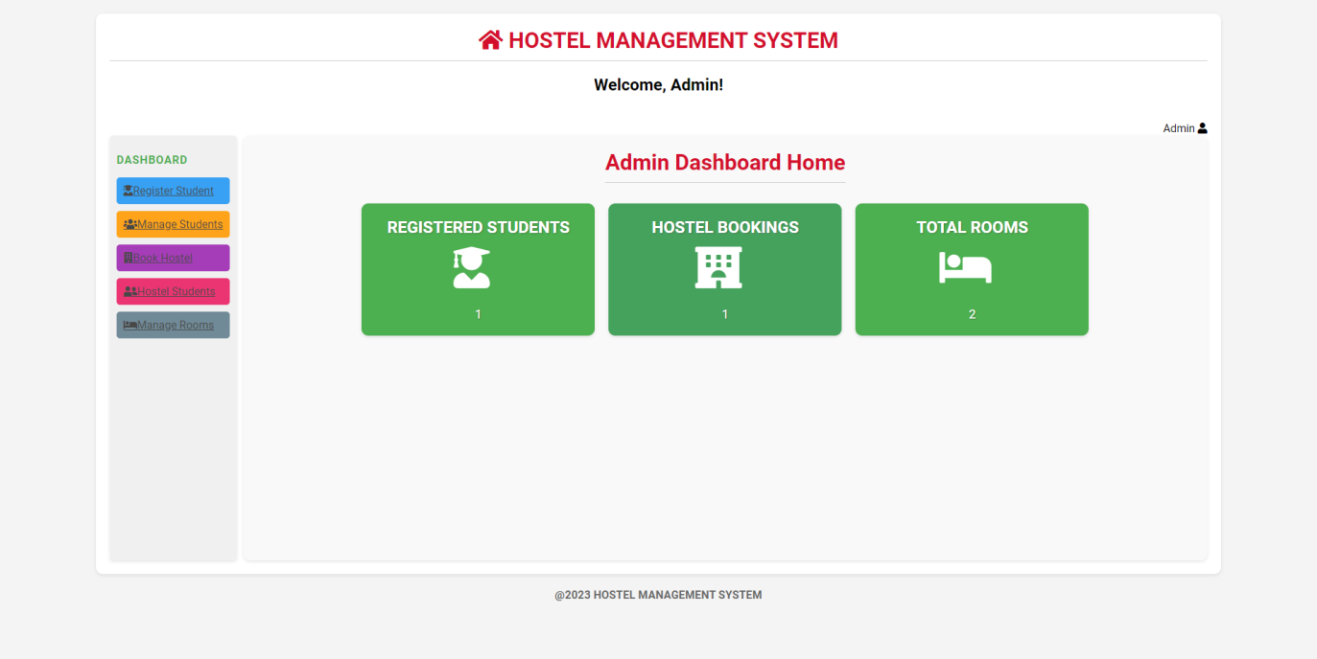
SCREEN SHOTS
ADMIN LOGIN
ADMIN
DASHBOARD

Slide 15
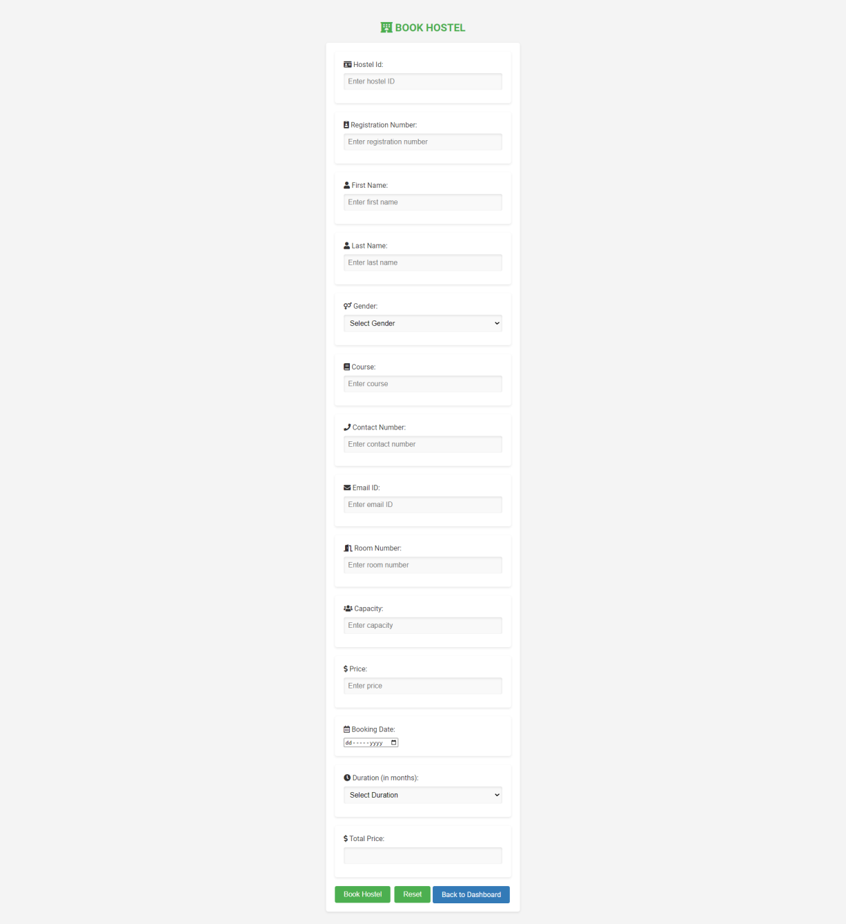
BOOK HOSTEL

Slide 16
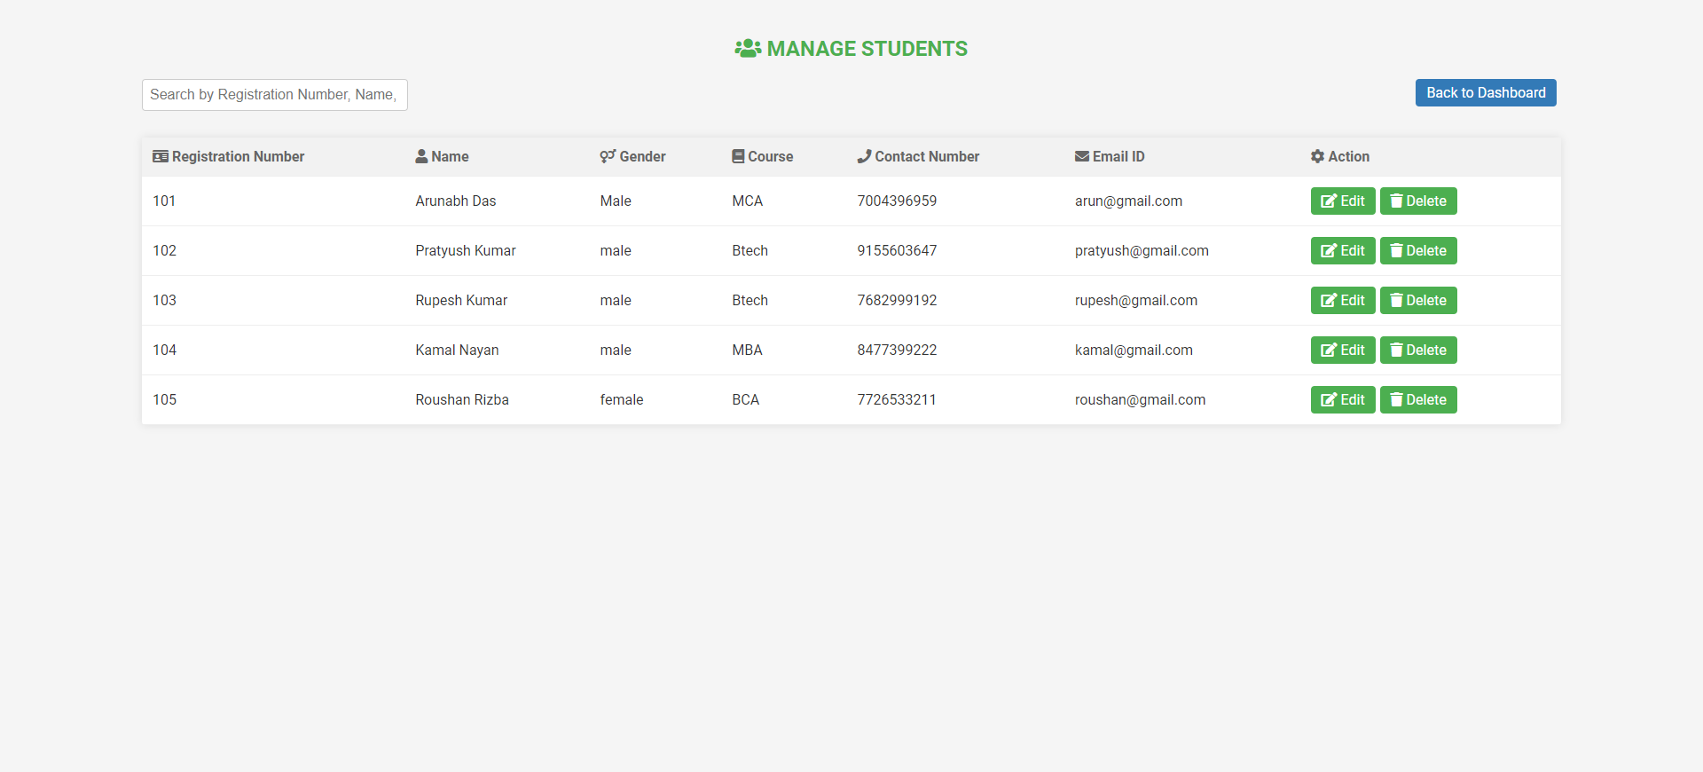
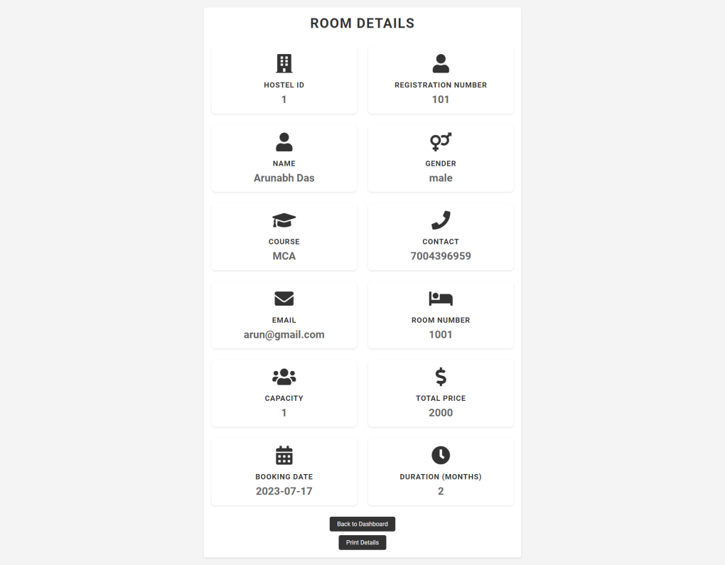
MANAGE
HOSTEL
STUDENTS
HOSTEL STUDENT
ROOM DETAILS

Slide 17
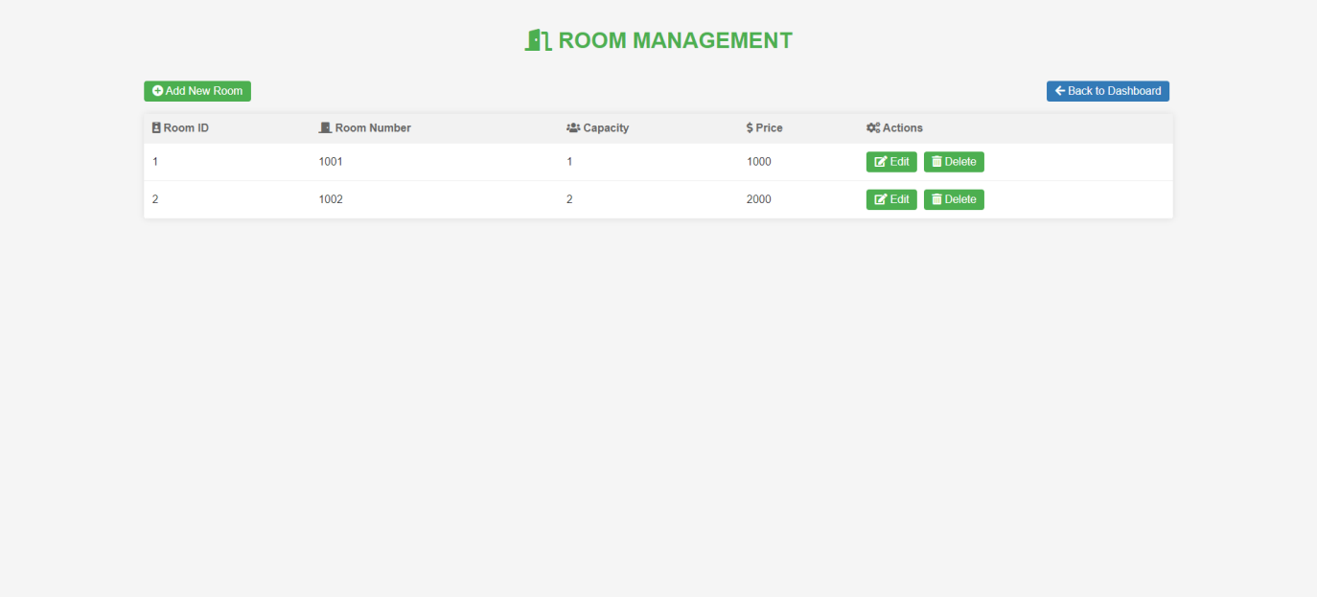
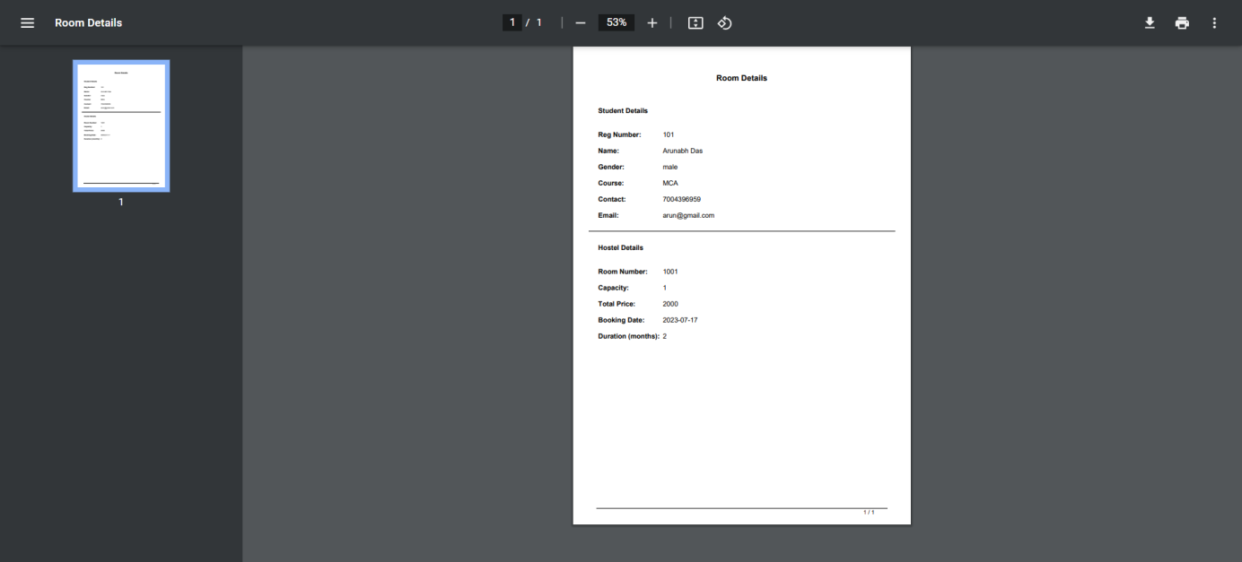
ROOM
MANAGEMENT
PRINT DETAILS

Slide 18
CONCLUSION
Student is provided the option for booking and Viewing Details.
Data storage and retrieval will became faster and easier to maintain.
This project offers student to enter the data through simple and interactive manner.

Slide 19
THANK YOU!

